Slide 1
ANALYSIS OF WATER QUALITY IN INDIA OVER TIME AND THEIR EFEECT AND CONSEQUENCES

Slide 2
WHY ANALYSE WATER QUALITY
Water is of major importance to all living things; in some organisms, up to 90% of their body weight comes from water.
Up to 60% of the human adult body is water.
The quality of water, whether used for drinking, domestic purposes, food production or recreational purposes has an important impact on health

Slide 3
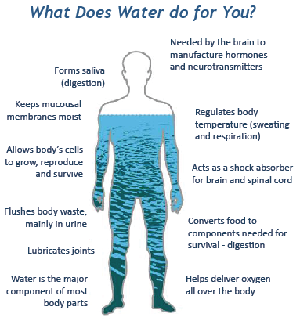
WHY ANALYSE WATER QUALITY

Slide 4
Total Coliform(MPN/100 ml)
Total Coliform(MPN/100 ml)
belonging to a group of rod-shaped bacteria typified by E. coli.
Coliform bacteria are a commonly used indicator of sanitary quality of foods and water. They are defined as rod-shaped Gram-negative non-spore forming and motile or non-motile bacteria which can ferment lactose with the production of acid and gas when incubated at 35–37°C.

Slide 5
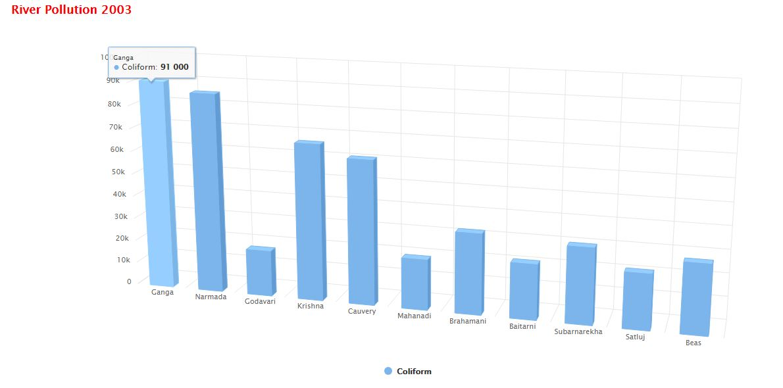
WATER QUALITY OF INDIAN RIVER (2003)

Slide 6
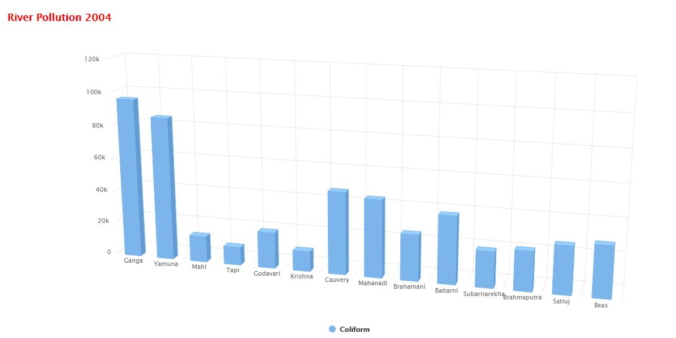
WATER QUALITY OF INDIAN RIVER (2004)

Slide 7
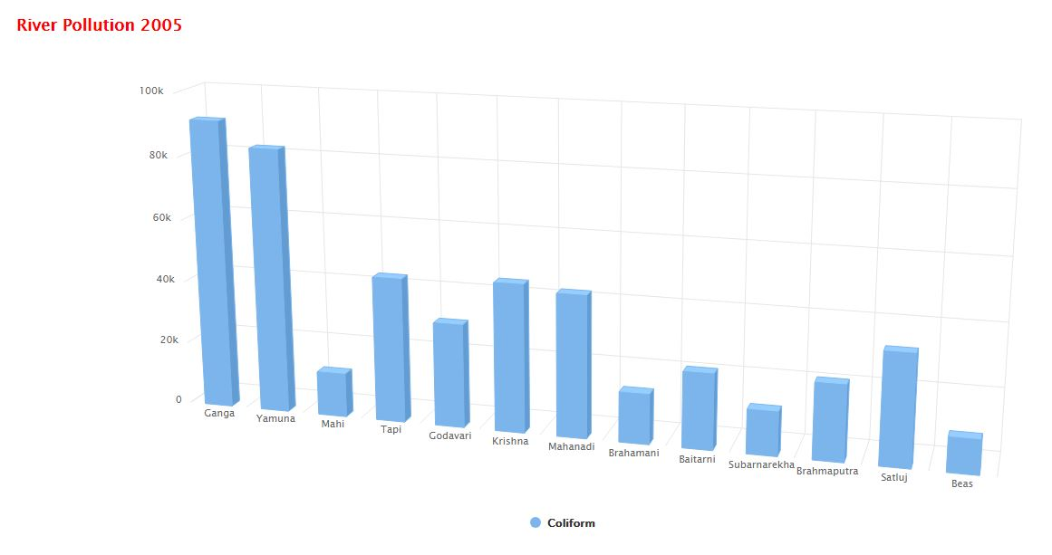
WATER QUALITY OF INDIAN RIVER (2005)

Slide 8
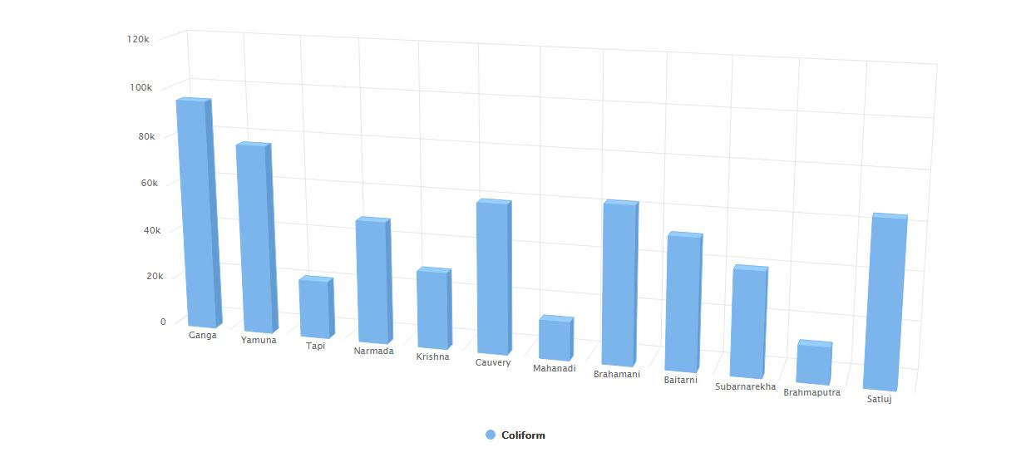
WATER QUALITY OF INDIAN RIVER (2011)

Slide 9
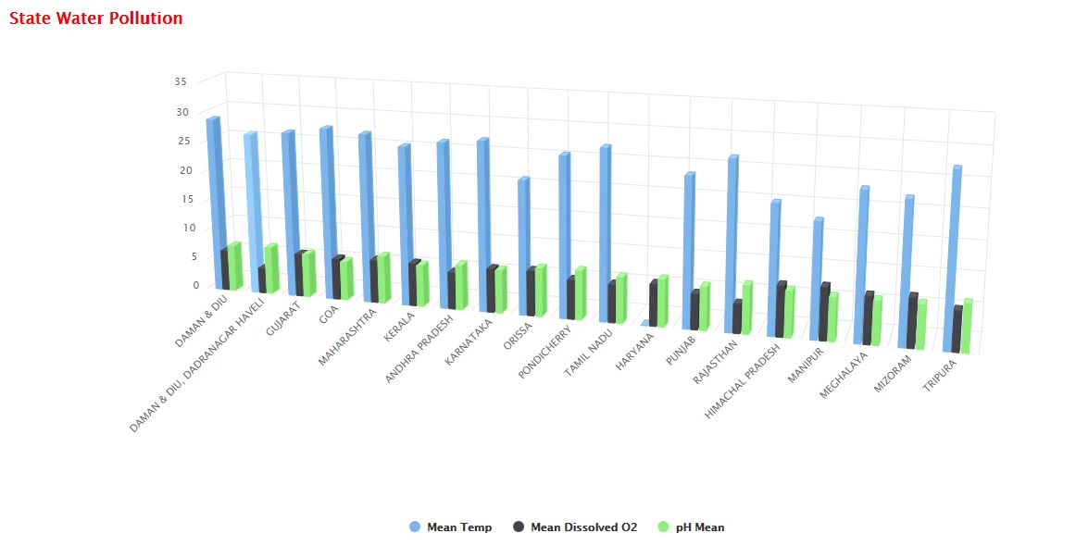
STATEWISE ANALYSIS (PH, DISSOLVED 02,MEAN TEMP)

Slide 10
Drinking water standard
2011 the World Health Organization suggested a level of fluoride from 0.5 to 1.0 mg/L (milligrams per litre), depending on climate, local environment, and other sources of fluoride.^{[6]} Bottled water typically has unknown fluoride levels.^{[7]}

Slide 11
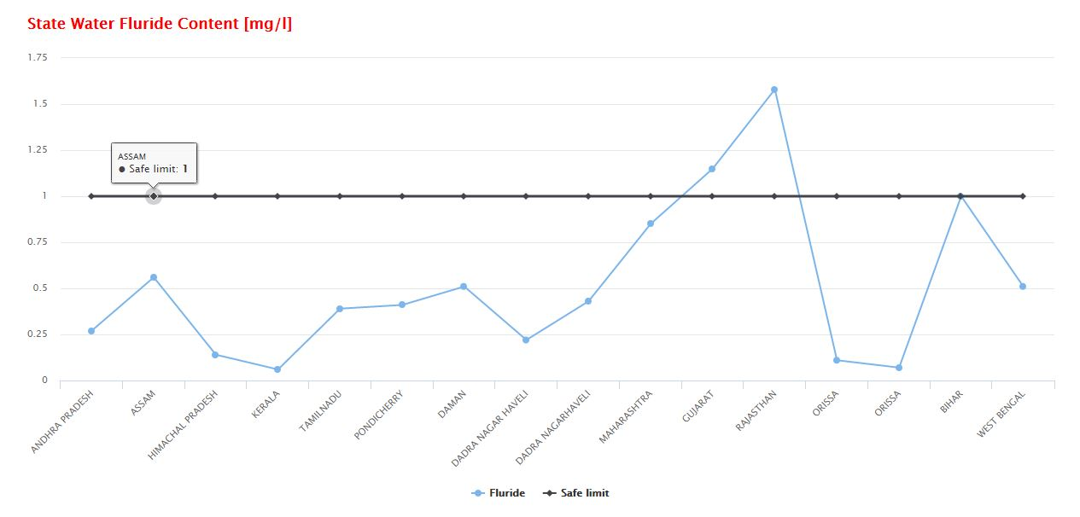
Drinking water standard

Slide 12
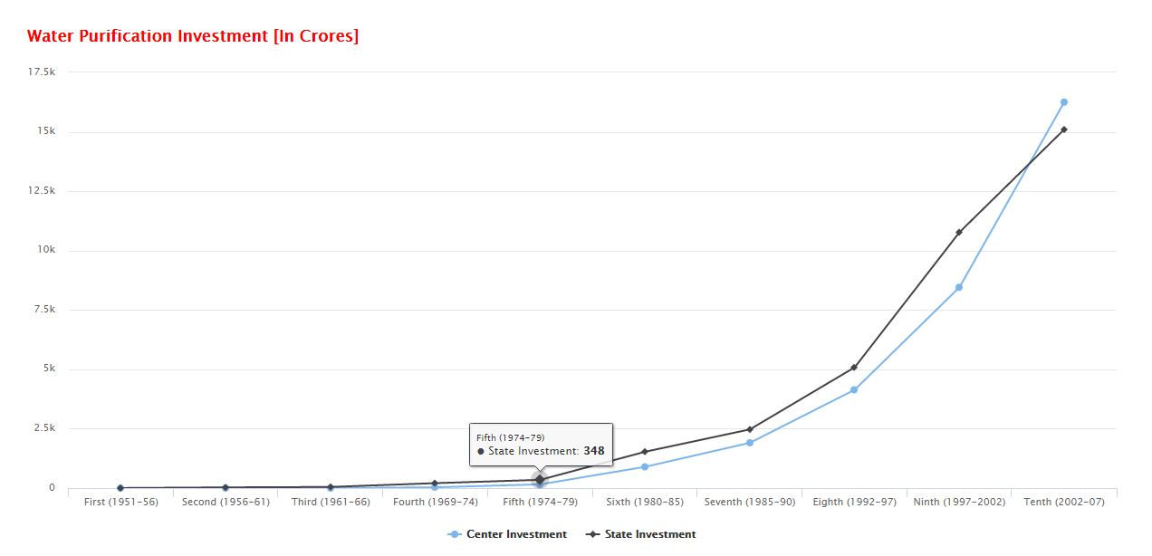
GOVERNMENT INVESTION IN WATERPURIFICATION

Slide 13
Ganga Action Plan Phase I & II
Prime Minister Rajiv Gandhi launched Phase I in 1985,^{[2]} covering 25 Ganga towns in three states; Rs 862.59 crore were spent.
Phase II covered 59 towns in five states; Rs 505.31 cr were spent. Rivers such as Yamuna, Gomti, Damodar, Mahananda had separate action plans

Slide 14
Mission Clean Ganga
"Mission Clean Ganga" project on 31 December 2009^{[2]} with the objective that by 2020, no municipal sewage and industrial waste would be released in the river without treatment, with the total budget of around Rs.15,000 crore. [
Cleaning Ganga will take 18 years, massive investment, Centre tells Supreme Court (Sep 22, 2014)

Slide 15
Biochemical oxygen demand
Biochemical oxygen demand (BOD, also called biological oxygen demand) is the amount of dissolved oxygen needed (i.e., demanded) by aerobic biological organisms to break down organic material present in a given water sample at certain temperature over a specific time period. The BOD value is most commonly expressed in milligrams of oxygen consumed per litre of sample during 5 days of incubation at 20 °C and is often used as a surrogate of the degree of organic pollution of water.^{[1}

Slide 16
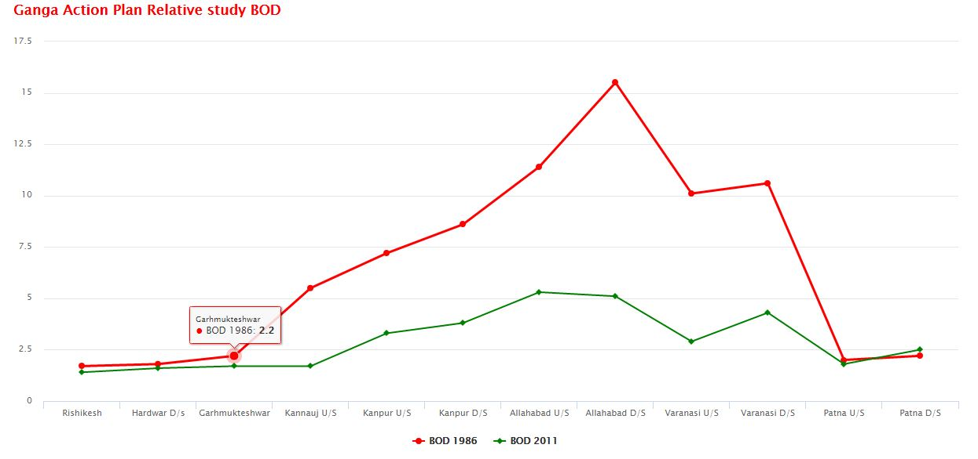
National Mission for Clean Ganga (NMCG)

Slide 17
Dissolved oxygen
Dissolved oxygen refers to the level of free, non-compound oxygen present in water or other liquids. It is an important parameter in assessing water quality because of its influence on the organisms living within a body of water. In limnology (the study of lakes), dissolved oxygen is an essential factor second only to water itself ¹. A dissolved oxygen level that is too high or too low can harm aquatic life and affect water quality.
Important for aquatic organism like fish,seahorsh,aerobic organism.

Slide 18
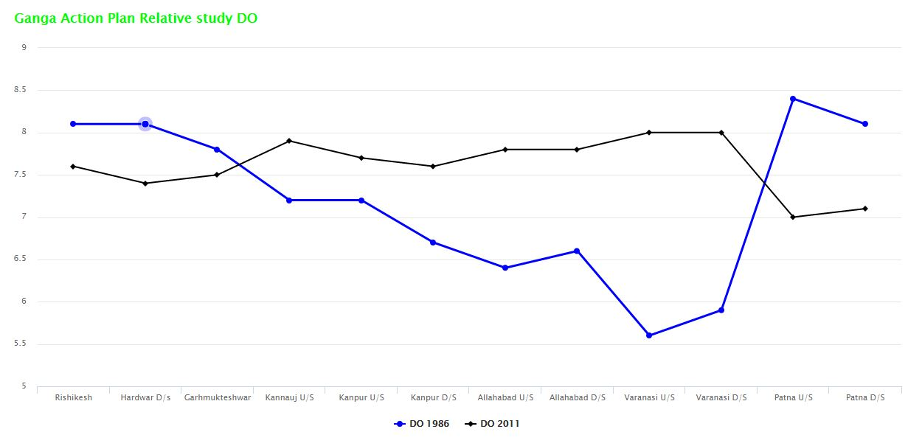
National Mission for Clean Ganga (NMCG)

Slide 19
Water discharge vs contribution to utility
Discharge (hydrology) In hydrology, discharge is the volume rate of water flow that is transported through a given cross-sectional area.

Slide 20
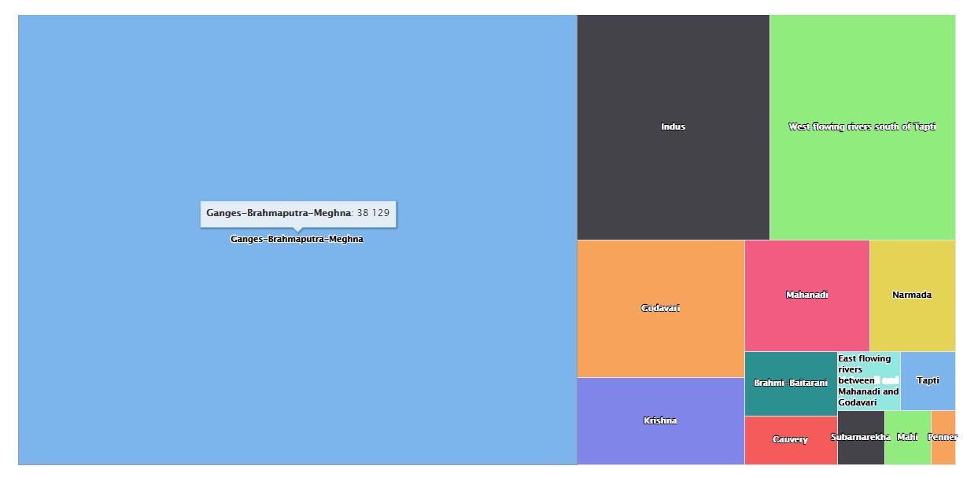
WATER DISCHARGE CONTRIBUTION TO WATER UTILITY

Slide 21
RENEWABLE WATER
Natural and actual renewable water resources. Natural renewable water resources are the total amount of a country's water resources (internal and external resources), both surface water and groundwater, which is generated through the hydrological cycle. The amount is computed on a yearly basis.
Total renewable is computed in water resources (km³)

Slide 22
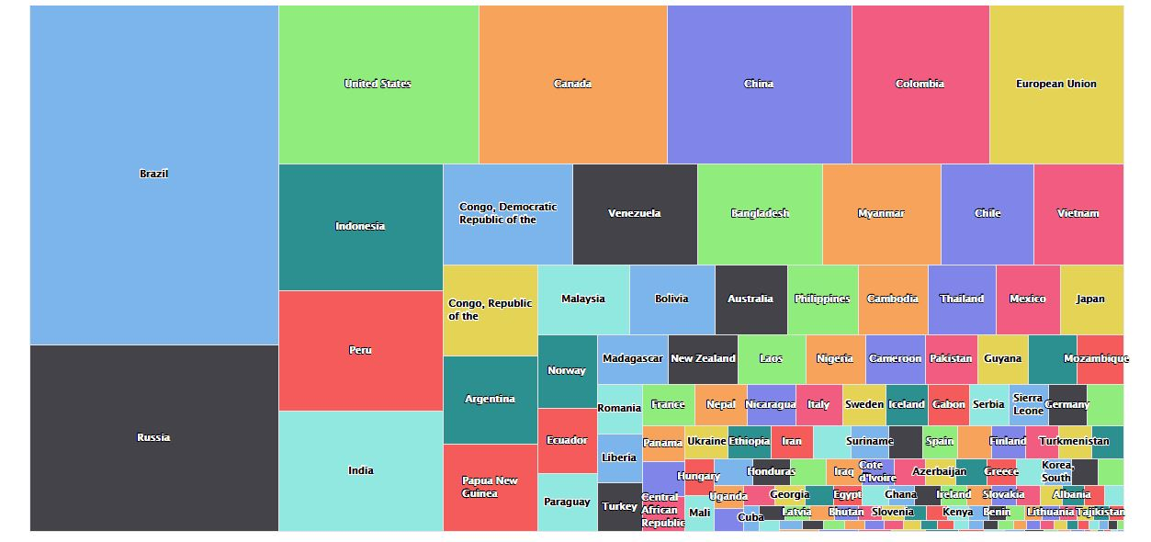
RENEWABLE WATER PRODUCTION INDIA VS WORLD(2011)

